Slide 1
Connecting to Data Source

Slide 2
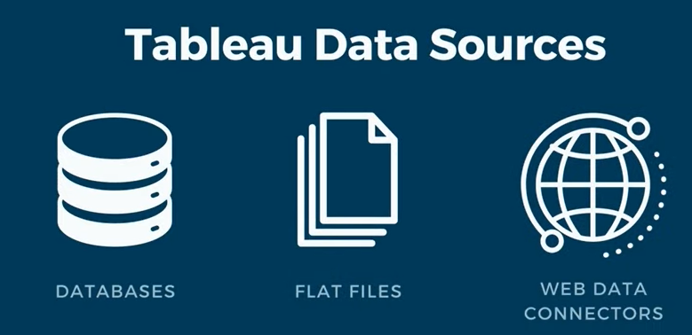
Tableau Data Sources

Slide 3
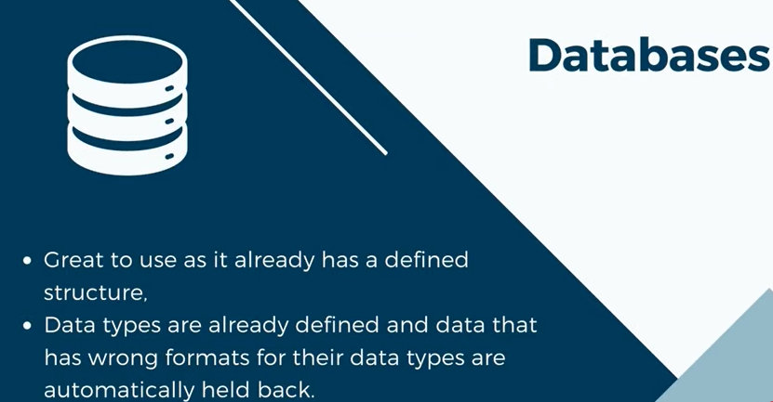
1. Databases

Slide 4
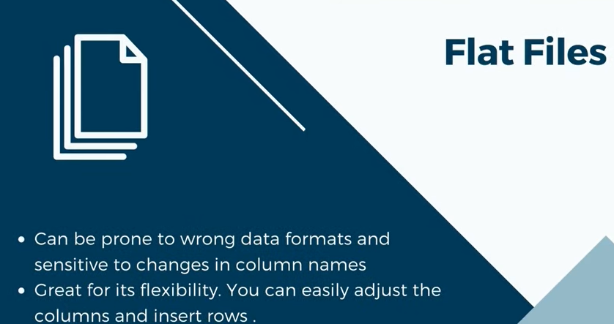
2. Flat files

Slide 5
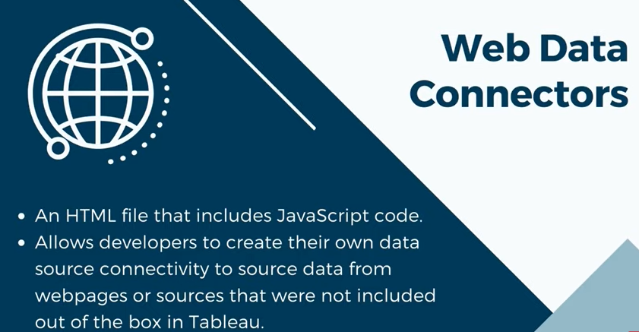
3. Web Data Connectors

Slide 6
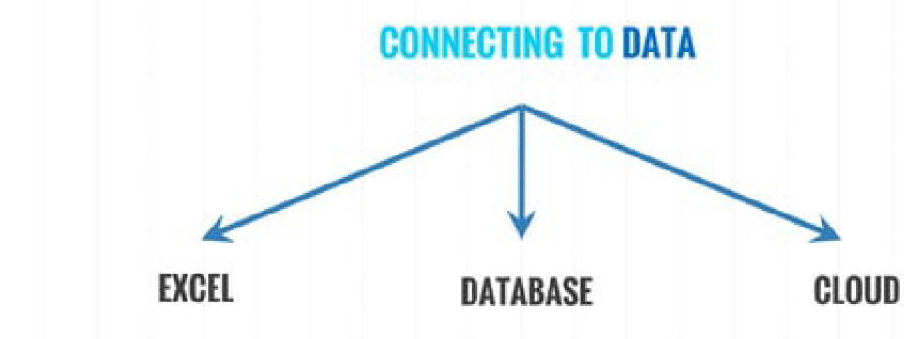

Slide 7
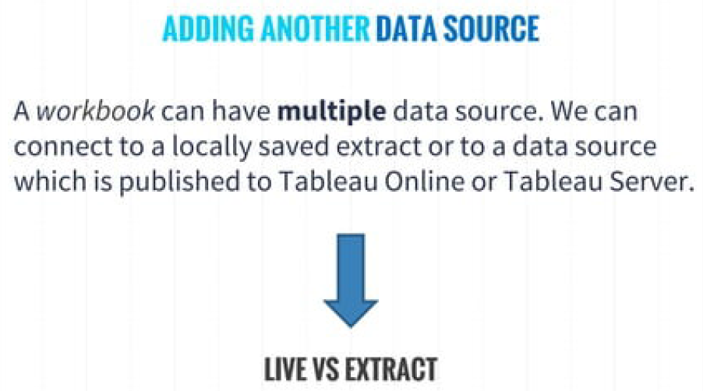

Slide 8
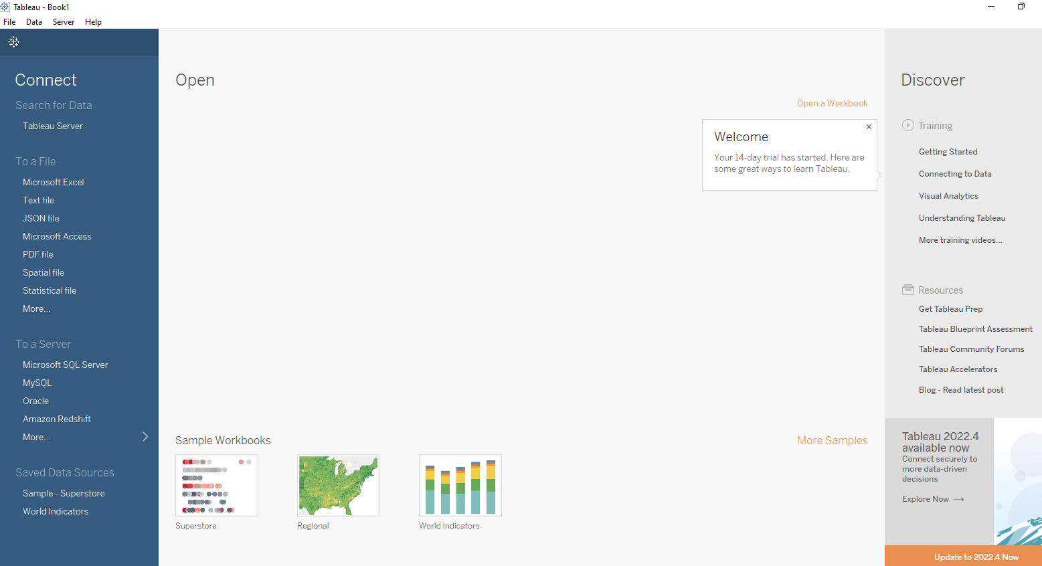
Tableau Desktop

Slide 9
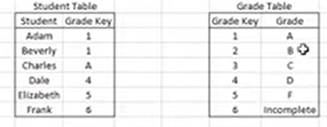
Joins

Slide 10

Inner Joins

Slide 11

Left Joins

Slide 12
Right Joins

Slide 13

Inner Joins

